Slide 1
Data INTERRELATION AND Frequency Analysis
By : ASHISH RANJAN
FOR Ph.D research work of : Farheen Rasheed(Assam University)
UNDER THE GUIDANCE OF DR.SYED ALFARID HUSSAIN

Slide 2
Research work description
Studying the social media behaviour of the Saudi Arabian Universities women on the basis of demographic data obtained.
Recent attempts by Saudi Arabia in being more open to changes had many reasons behind. One main reason behind it was the awareness among it’s citizens about human rights and a more open society.
Looking at the changing scenario in KSA, the research was conducted to study the social media behaviour of studying women as Saudi goes through a transformation.

Slide 3
Nature of data and analysis required
Nature of Data : The data was obtained in the form of table where each rows were numbered according to the questions asked and the column were numbered according to the woman who was answering the question.
Requirement :
Providing Frequency of Different types of data.
Find meaningful interrelations between the demographic data and social media behaviour using the data provided,
Providing suitable representations of the inference made through analysis.

Slide 4
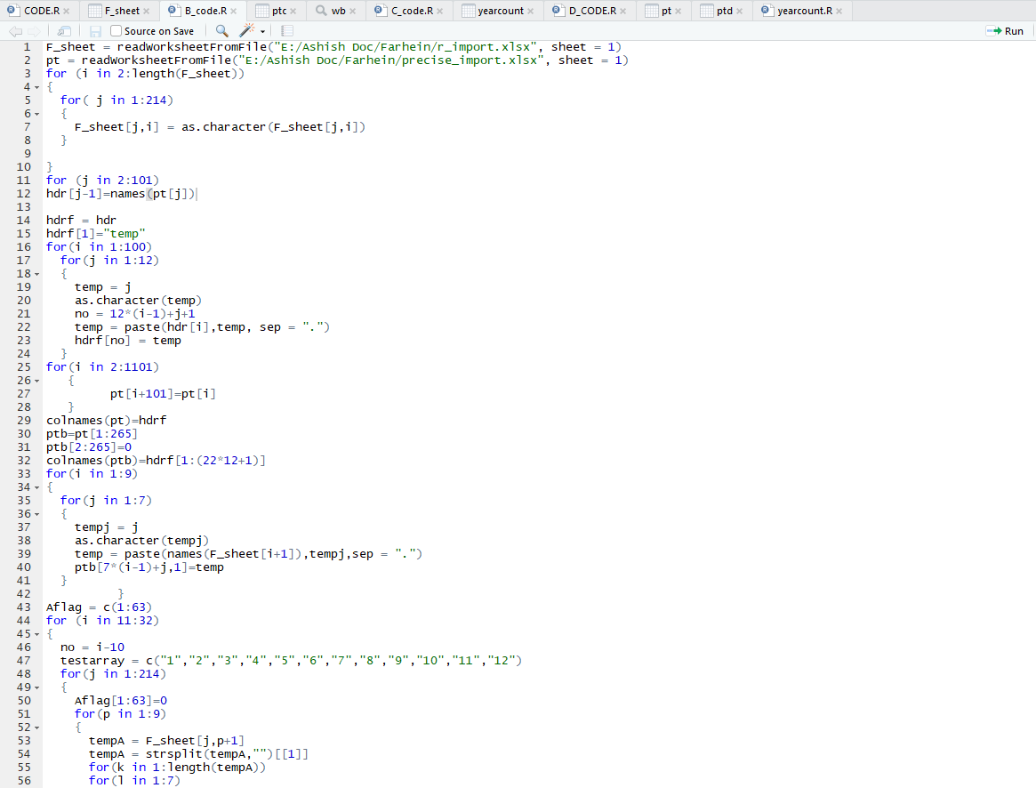
PLATFORMS USED
R/Rstudio : For Segregation and Extraction of
Frequency data.
MS-Excel : For Representation of Output.
An Excerpt of the code written on R-Platform

Slide 5
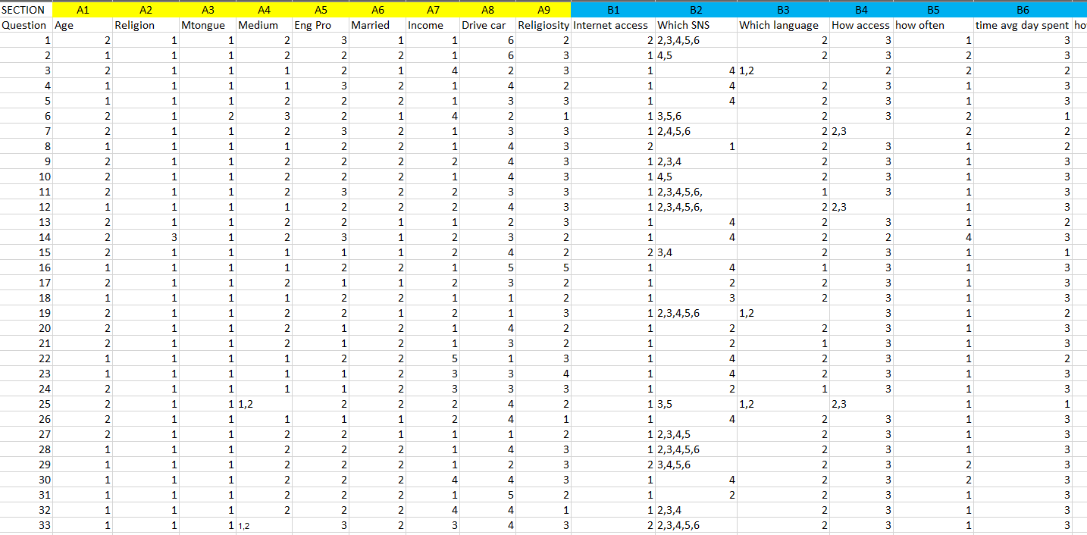
INPUT
A snap of the Statistical Data provided in tabular form

Slide 6
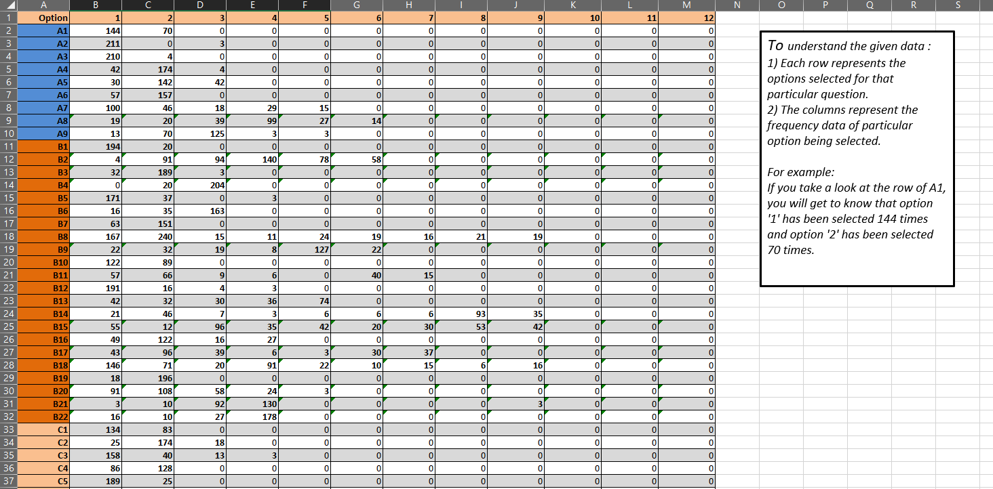
OUTPUT : I BASIC FREQUENCY DATA PROVIDED BASED ON THE QUESTIONS ANSWERED

Slide 7
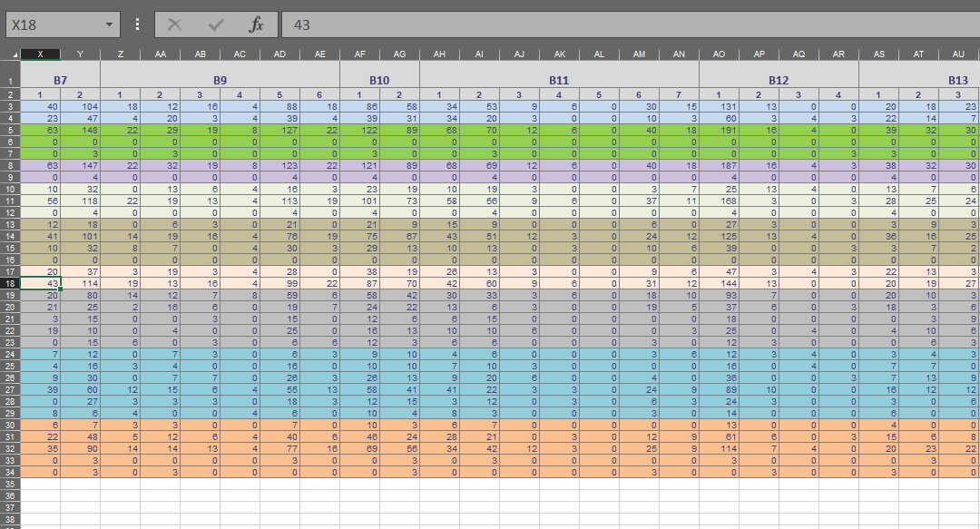
Output ii interrelation between data provided(frequency data for predicting behaviour based on demographic data) : Section b

Slide 8
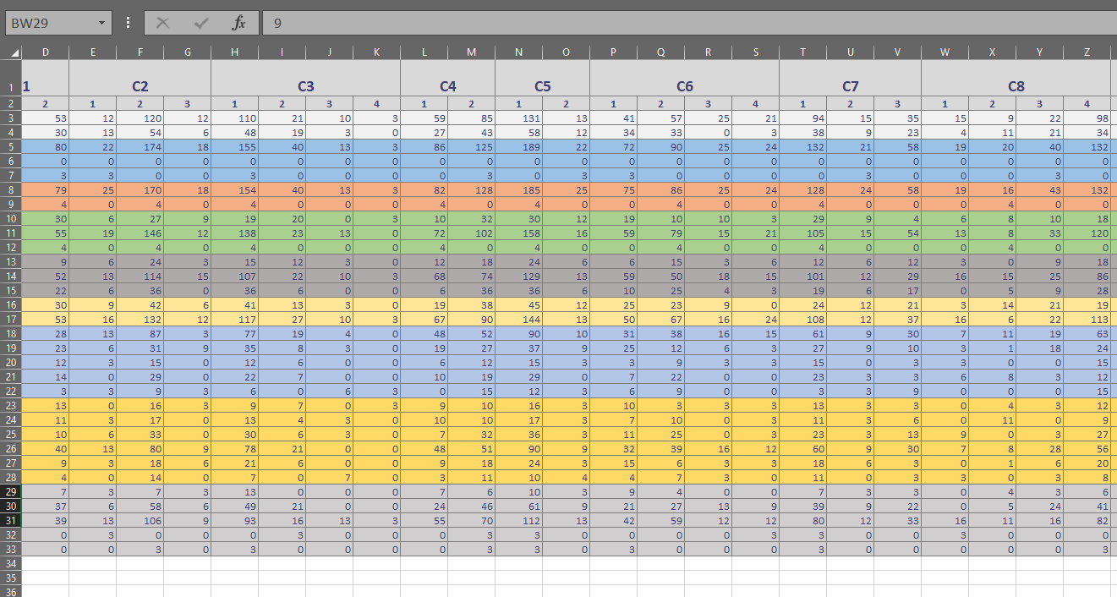
Output iii interrelation between data provided(frequency data for predicting behaviour based on demographic data) : section c

Slide 9
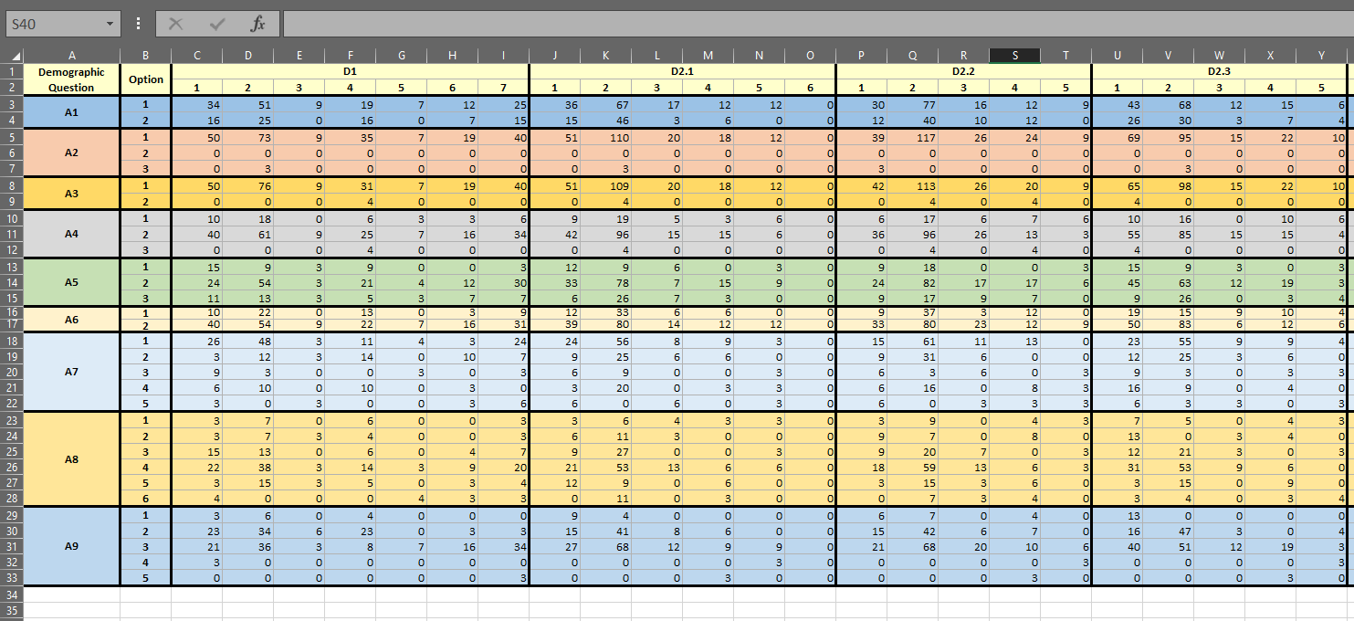
Output iv interrelation between data provided(frequency data for predicting behaviour based on demographic data) : section c

Slide 10
PLOTS PROVIDED

Slide 11
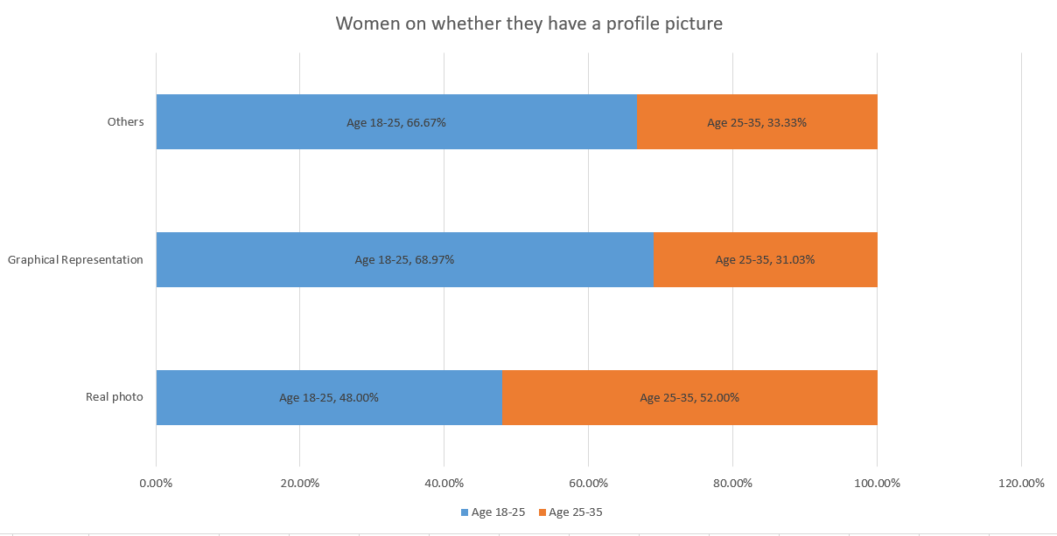

Slide 12
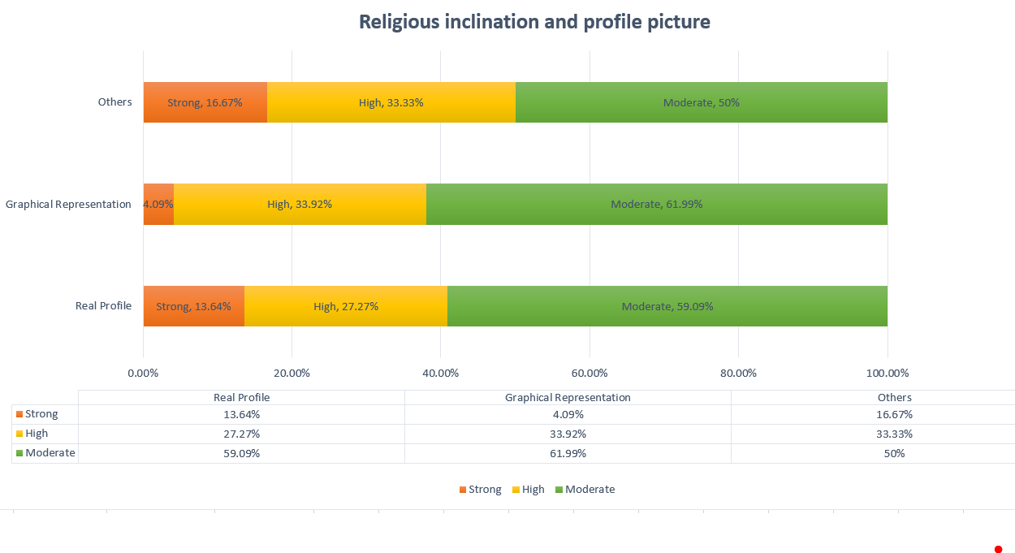

Slide 13
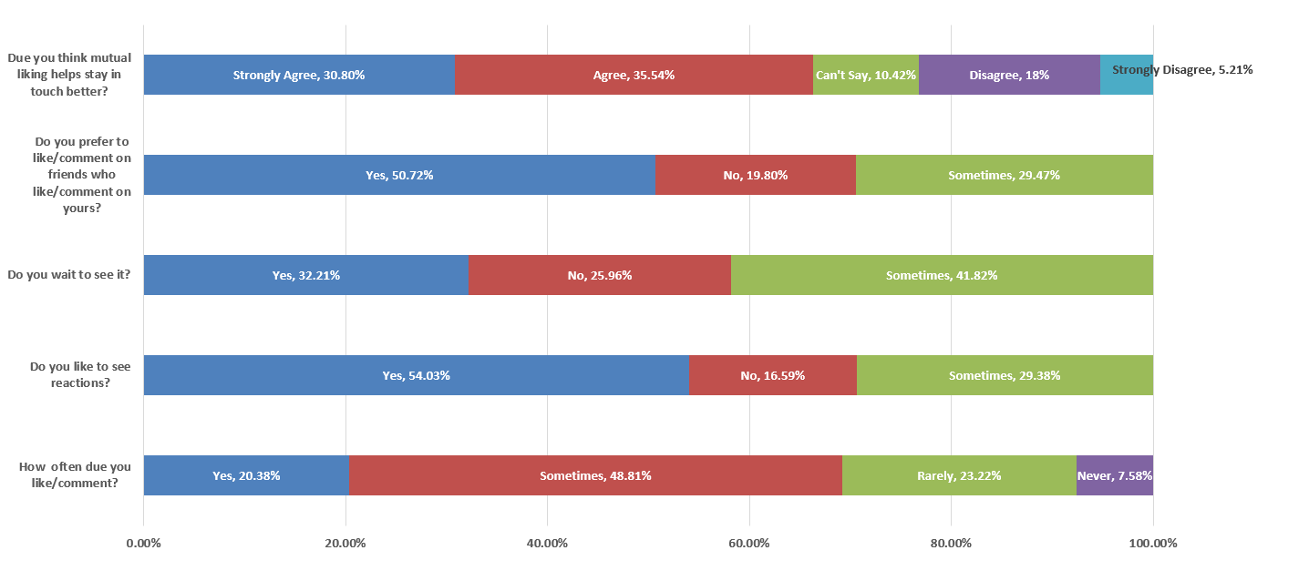

Slide 14
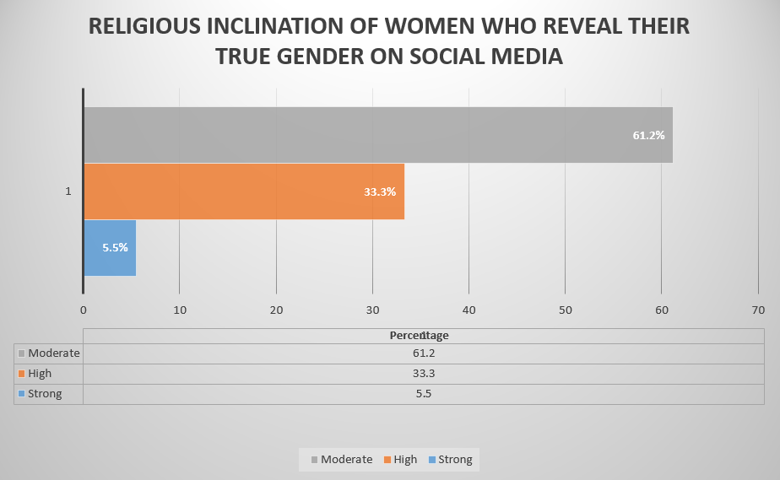

Slide 15
TASKS ACCOMLISHED
Providing Frequency of Different types of data.
Find meaningful interrelations between the demographic data and social media behaviour using the data provided.
Providing suitable representations of the inference made through analysis.

